Slide 1
Automated Products Recommendations
Background
Online Products Recommendation
Objectives
Build a Products recommendation solution online which involves using Machine learning training model based on aggregate customer purchasing model.

Slide 2
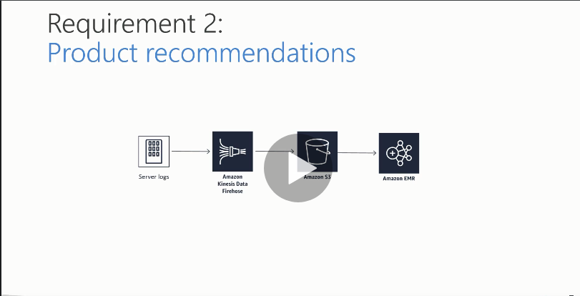
Design Solution Blueprint

Slide 3
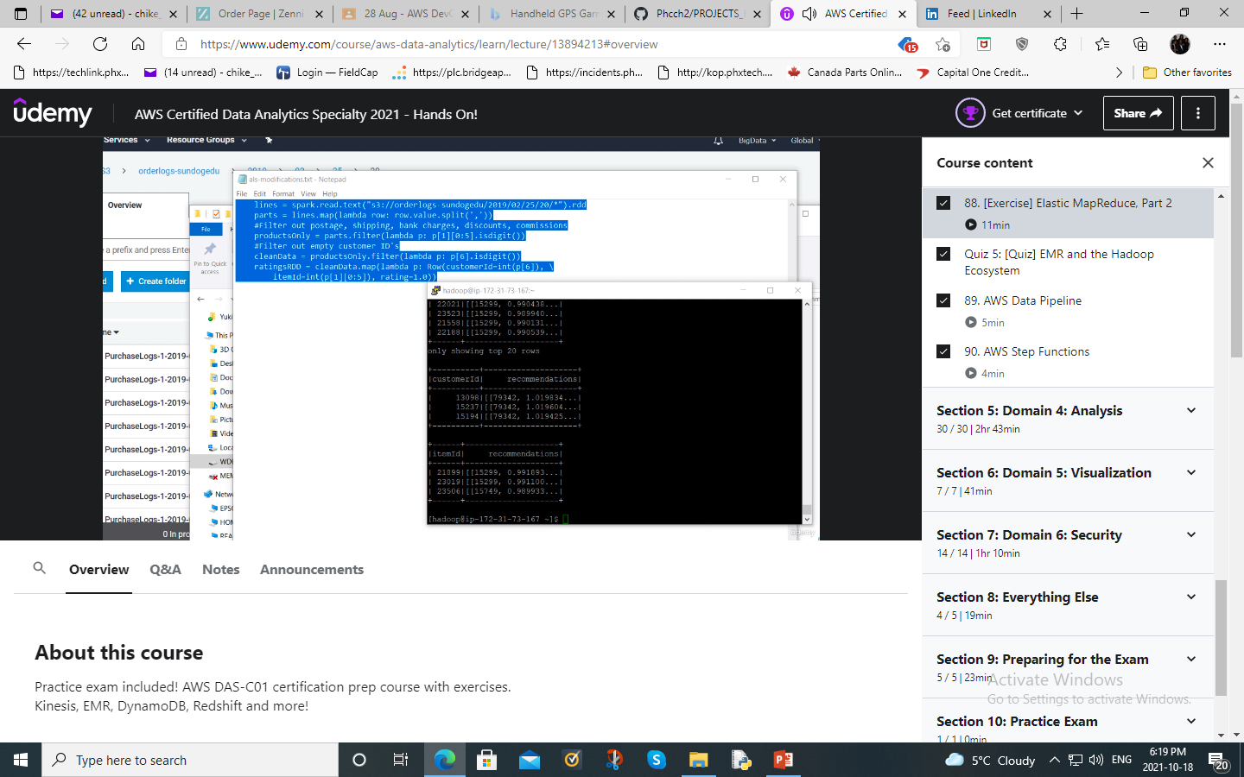
Customerid recommendations based on prediction in Apache Spark after running script

Slide 4
Process
Mechanics
Simulate order data from an EC2 instance (Use CLI and configure our logs to write into the Kinesis firehose that was created)Kinesis agent in the EC2 instance pumping the data into Kinesis Firehose delivery stream.
Publish that data using Kinesis Firehose into data lake hosted in Amazon S3 (Configure your buffer size and buffer interval in S3). The least amount of time for buffer interval is 60s.
Spin up an EMR (Elastic Map Reduce) using M5xlarge instances (1 Master and 2 Slave Nodes), run Apache spark using ML Library to generate recommendations based on order data in S3 data lake.
Machine learning is a heavy CPU operation, so you have to choose your instances, if you were doing deep learning, you might have to use a GPU instance
Add ssh port 22 into your Master Node, copy some Pyspark script from the Machine learning Library. The data should be copied into a HDFS file system and implicitly is accessible to other slave nodes since it is shared.
The script is an als (least square algorithm) that extracts our PurchaseLog data on S3 and trains the model that will be used to make recommendations. We can generate the top 10 recommendations on the purchase records using Customerid.

Slide 5
Security
Create a new role for Kinesis Firehose to access our S3 bucket. (Default policy for Kinesis Firehose gives it access to Kinesis Data Streams, AWS Lambda and Amazon S3)
Create a new role for our EC2 instance and give it an Administrative Access role so that it can read and write to most services.
Make your S3 data (500,000) PurchaseLogs Public so that it is accessible to all

